Slide 1
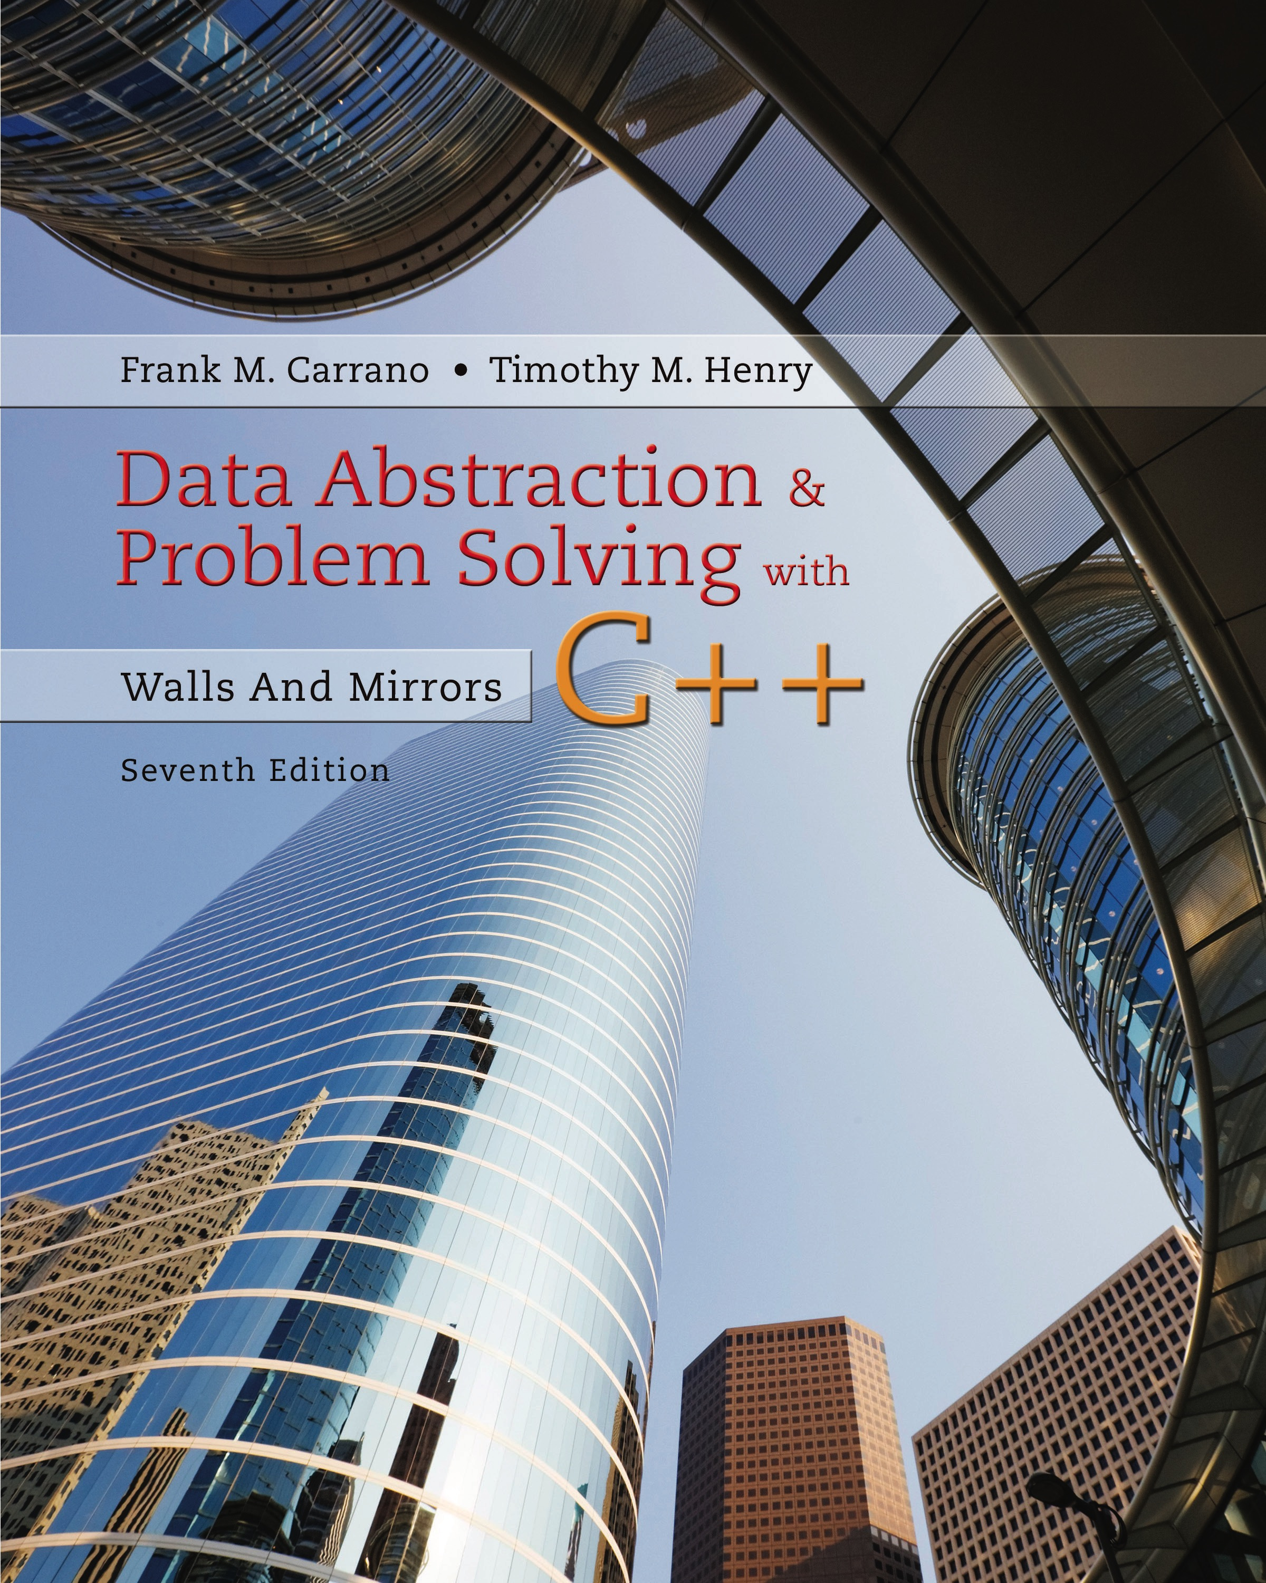
Data Abstraction & Problem Solving with C++: Walls and Mirrors
Seventh Edition
C++ Interlude 4
Safe Memory Management Using Smart Pointers
Copyright © 2017, 2013, 2007 Pearson Education, Inc. All Rights Reserved
Notes:
If this PowerPoint presentation contains mathematical equations, you may need to check that your computer has the following installed:
1) MathType Plugin
2) Math Player (free versions available)
3) NVDA Reader (free versions available)

Slide 2
Raw Pointers (1 of 3)
Allocate memory in free store by using new operator
Returns reference to newly created object in memory
Store reference to object in a pointer variable
Use pointer variable to access object
Copy reference to another pointer variable
Creates alias to same object

Slide 3
Raw Pointers (2 of 3)
Use delete operator to deallocate object’s memory
Must also set to null p t r any pointer variables that referenced the object
Need to keep track number of aliases that reference an object … else results in
Dangling pointers
Memory leaks
Other errors (program crash, wasted memory, …)

Slide 4
Raw Pointers (3 of 3)
Languages such as Java and Python disallow direct reference to objects
Use reference counting to track number of aliases that reference an object
Known as the “reference count”
Language can detect when object no longer has references
Can deallocate … known as “garbage collection”

Slide 5

Smart Pointers (1 of 2)
C++ now supports “smart” pointers (or managed pointers)
Act like raw pointers
Also provide automatic memory management features
When you declare a smart pointer
Placed on application stack
Smart pointer references an object
object is
“managed”

Slide 6
Smart Pointers (2 of 2)
Smart-pointer templates
shared_p t r – provides shared ownership of object
unique_p t r – no other pointer can reference same object
weak_p t r – reference to an object already managed by a shared pointer … does not have ownership of the object

Slide 7
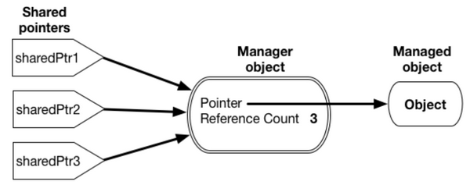
Using Shared Pointers (1 of 2)
Figure C4-1 Shared pointers and the manager object referencing a managed object.

Slide 8
Using Shared Pointers (2 of 2)
A shared pointer …
Provides a safe mechanism to implement shared object ownership
Maintains a count of aliases to an object
Decreases or increases reference count of managed object each time instance is created or goes out of scope or is assigned null p t r
Calls destructor of managed object when reference count reaches 0

Slide 9
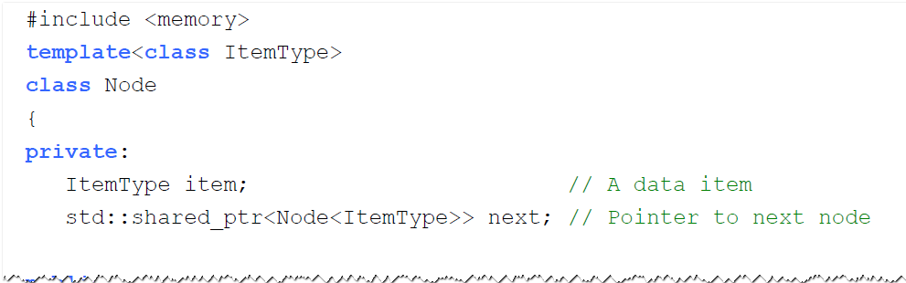
Revised Node and LinkedList Classes (1 of 11)
Use shared pointers in earlier Node and LinkedList classes
Help ensure memory handled correctly
Listing C4-1 The revised header file for the class Node, originally given in Listing 4-1

Slide 10
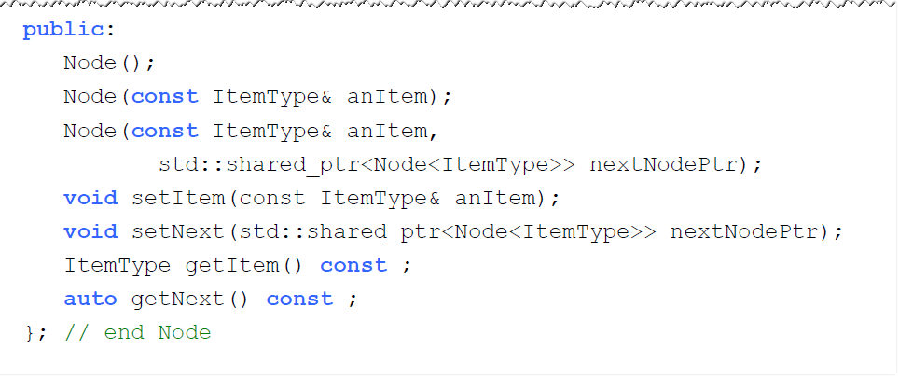
Revised Node and LinkedList Classes (2 of 11)
Listing C4-1 [Continued]

Slide 11
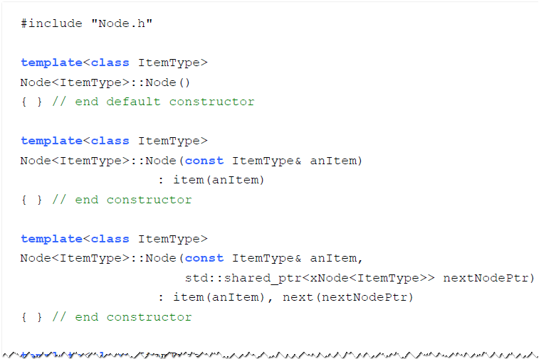
Revised Node and LinkedList Classes (3 of 11)
Listing C4-2 The revised implementation file for the class Node, originally given in Listing 4- 2

Slide 12
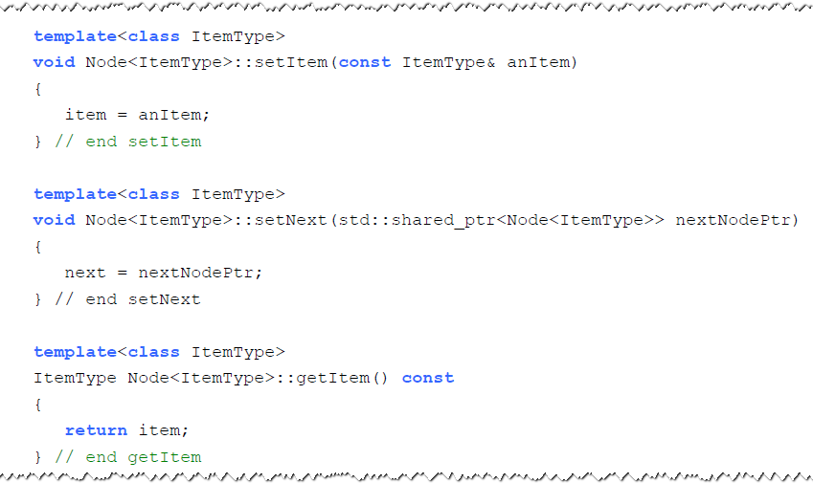
Revised Node and LinkedList Classes (4 of 11)
Listing C4-2 [Continued]

Slide 13
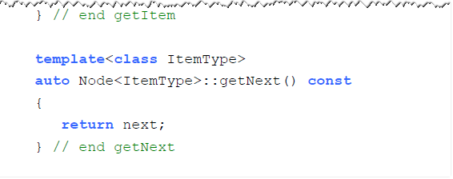
Revised Node and LinkedList Classes (5 of 11)
Listing C4-2 [Continued]

Slide 14
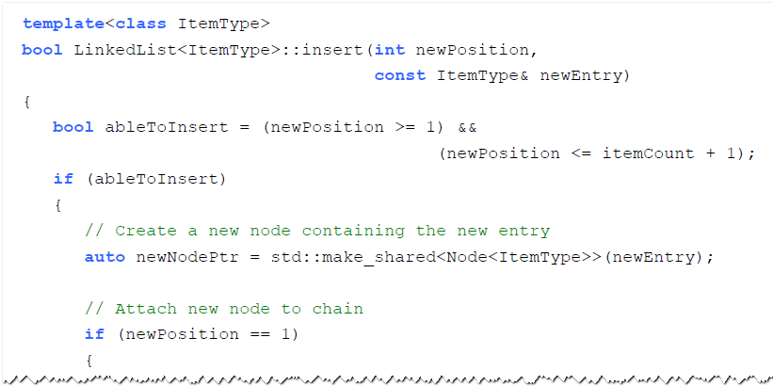
Revised Node and LinkedList Classes (6 of 11)
Listing C4-3 The insert method for LinkedList

Slide 15
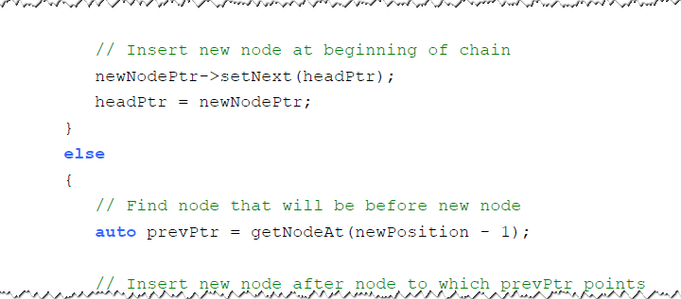
Revised Node and LinkedList Classes (7 of 11)
Listing C4-3 [Continued]

Slide 16
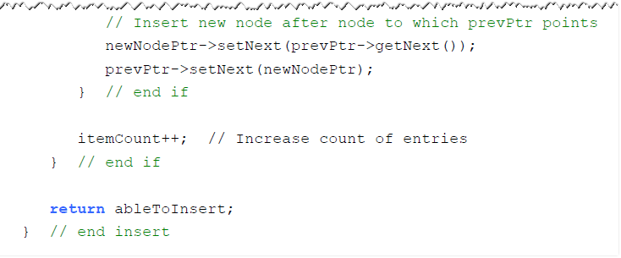
Revised Node and LinkedList Classes (8 of 11)
Listing C4-3 [Continued]

Slide 17
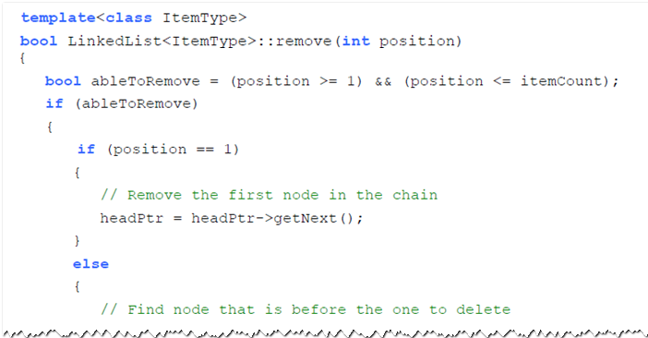
Revised Node and LinkedList Classes (9 of 11)
Listing C4-4 The remove method for LinkedList

Slide 18
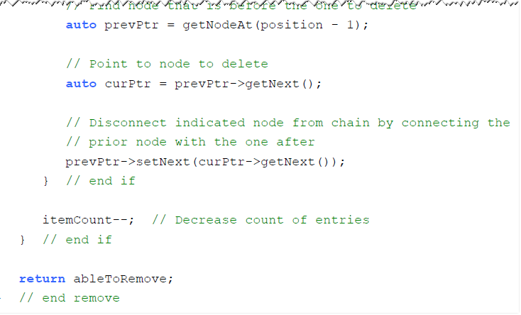
Revised Node and LinkedList Classes (10 of 11)
Listing C4-4 [Continued]

Slide 19
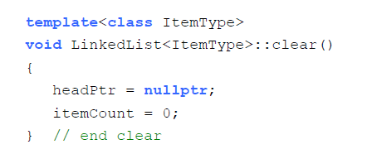
Revised Node and LinkedList Classes (11 of 11)
clear method for LinkedList

Slide 20
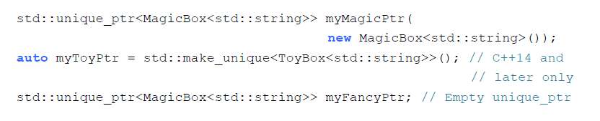
Using Unique Pointers (1 of 3)
Different ways to create unique pointers.

Slide 21
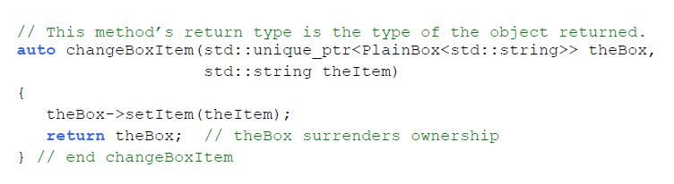
Using Unique Pointers (2 of 3)
Function that accepts ownership of an object and then returns it to the caller

Slide 22
Using Unique Pointers (3 of 3)
A unique pointer …
Has solitary ownership of its managed object
Behaves as if it maintains a reference count of either 0 or 1 for its managed object
Can transfer its unique ownership of its managed object to another unique pointer using method move
Cannot be assigned to another unique pointer

Slide 23
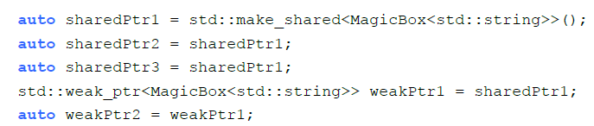
Using Weak Pointers (1 of 4)
Weak pointer only observes managed object
But does not have ownership
Therefore, cannot affect its lifetime
After these statements execute, reference count for object managed by shared P t r1 is 3

Slide 24
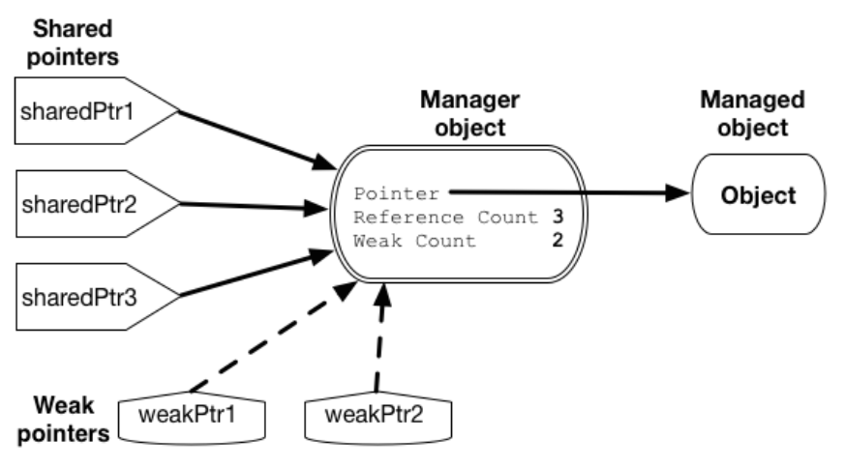
Using Weak Pointers (2 of 4)
Figure C4-2 Weak and shared ownership of a managed object

Slide 25
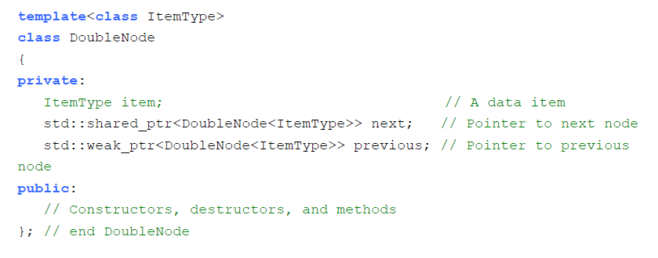
Using Weak Pointers (3 of 4)
Listing C4-5 Partial header file for the class DoubleNode

Slide 26
Using Weak Pointers (4 of 4)
A weak pointer …
References but does not own an object referenced by shared pointer
Cannot affect lifetime of managed object
Does not affect reference count of managed object
Has method lock to provide a shared-pointer version of its reference
Has method expired to detect whether its reference object no longer exists

Slide 27
Other Smart Pointer Features (1 of 2)
Method common to all smart pointers
reset
Method common to all shared and unique pointers
get
Methods exclusive to shared pointers
unique
use_count

Slide 28
Other Smart Pointer Features (2 of 2)
Method exclusive to unique pointers
release
Unique pointers with arrays
Use a unique pointer to manage a dynamic array

Slide 29

Copyright

